Slide 1
Advanced Data Management – Week 1
Introduction to Data Management and Relational Systems

Slide 2
Lecture Objectives
By the end of this lecture, students should be able to:
Explain the historical evolution of data management systems
Analyze the limitations of Relational Database Management Systems (RDBMS) in large-scale environments
Describe the fundamental characteristics of Big Data (Volume, Velocity, Variety)
Distinguish the architectural and philosophical differences between relational and NoSQL databases
Justify why database selection is an architectural decision in modern distributed systems

Slide 3
Course Context & Evolution of Data Management
Transition from file-based systems to DBMS
Dominance of relational databases
Emergence of large-scale distributed applications
Rise of Big Data and NoSQL architectures

Slide 4
What is Data Management?
Data Management refers to the set of principles, processes, technologies, and practices that ensure that an organization’s data are collected, stored, organized, protected, and utilized in a reliable, efficient, and secure manner.
Its objective is not simply the storage of data, but their transformation into useful, reliable, and reusable information throughout their lifecycle.

Slide 5
What “Data Management” Means
The term data management includes a broad range of activities such as:
Designing the structure of data
Storing and retrieving data
Ensuring quality, consistency, and integrity
Security and access control
Compliance with regulatory frameworks
Supporting analytics and decision-making
In other words, data management answers the question: How do we manage data so that they are always available, correct, and useful when required by the information system?

Slide 6
Why Data Are a Central Element of Every Information System
Every information system, regardless of application or domain, has as its primary purpose the management of data.
Applications:
Input data
Process them
Produce output
Without data:
There is no information
No automation
No knowledge
No decision support
Data constitute the permanent and long-term component of a system, unlike applications that change or are replaced. For this reason, their proper management is critical for the sustainability, reliability, and scalability of every information system.

Slide 7
Role of the Database as an Intermediate Layer Between Application and Storage
The database functions as the intermediate layer (middleware) between:
Applications (logic and user interface)
Physical storage media (disks, cloud storage, distributed systems)
Its role is crucial because it:
Hides physical storage details from the application
Provides a unified and structured way to access data
Guarantees integrity, consistency, and concurrent multi-user access
Implements security, transaction, and recovery mechanisms
Thus, the application does not directly manage files or disks, but communicates with the database, which handles all the complexity of storage and data management.
In conclusion, data management constitutes the foundation of every modern information system, with the database serving as the reliable and controlled connector between application logic and underlying storage infrastructure.

Slide 8
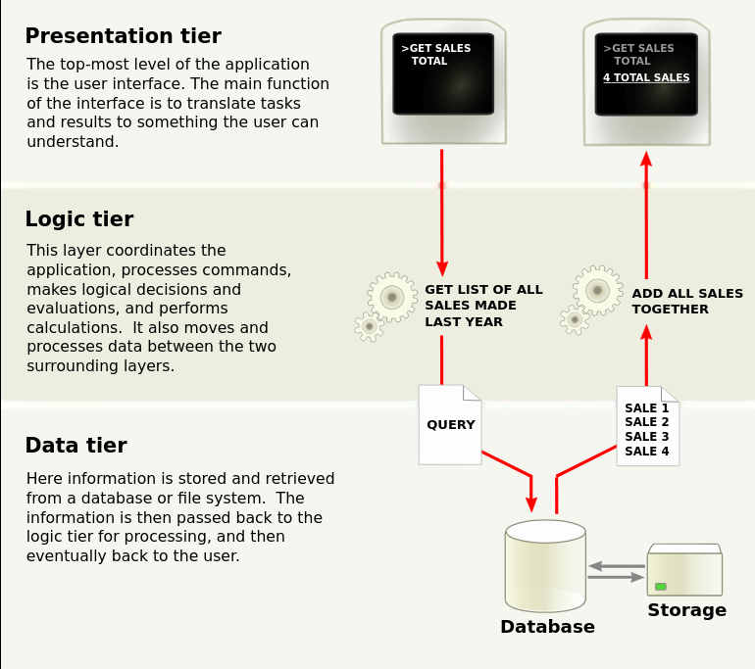
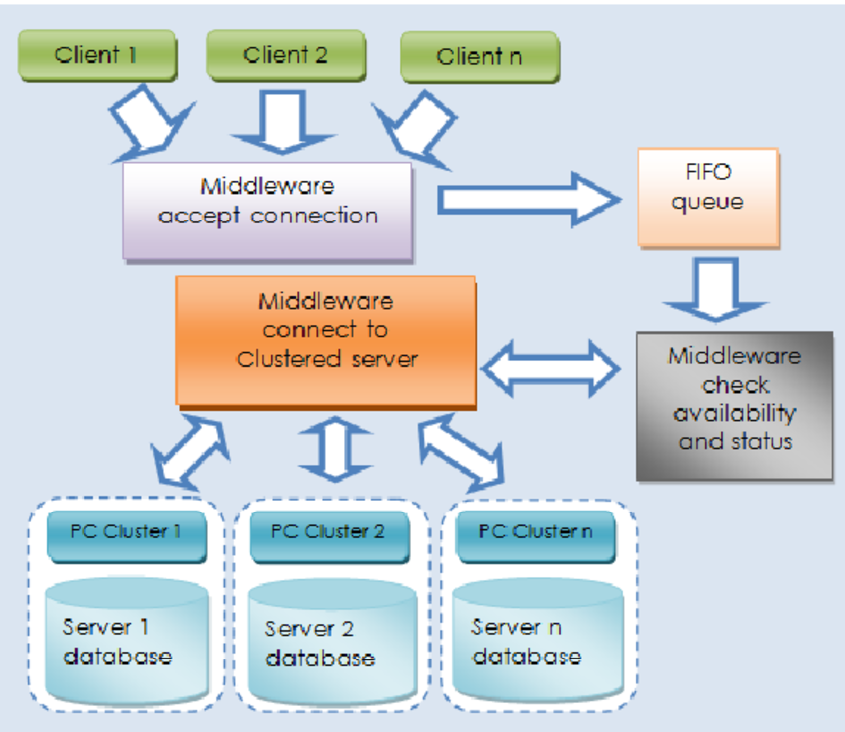
Role of the Database as an Intermediate Layer Between Application and Storage

Slide 9
File-based Systems
Before the emergence of Database Management Systems (DBMS), most information systems relied on file-based systems.
In this approach, each application managed its data directly through operating system files, without an intermediate management layer.
File-based systems represented the first step in organizing digital data, but the increasing complexity of applications quickly exposed their structural limitations.

Slide 10
Storage of Data in Files
In file-based systems:
Data are stored in simple files (e.g., text, binary, CSV)
Each application defines its own file structure
Reading and writing are performed directly by application code
There is no central control or integration mechanism
The file simultaneously serves as both storage medium and logical data model.

Slide 11
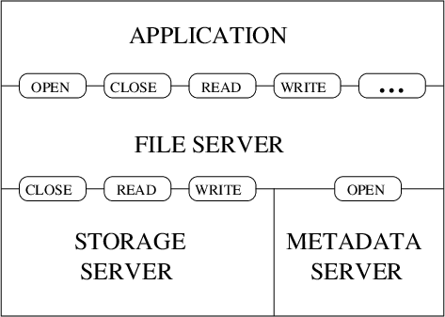
Tight Coupling Between Data and Code
A central characteristic of file-based systems is tight coupling:
The data structure is hard-coded into the application
Any change in file format requires code modifications
The application “knows” storage details
This means that data are not independent from the application that uses them.

Slide 12
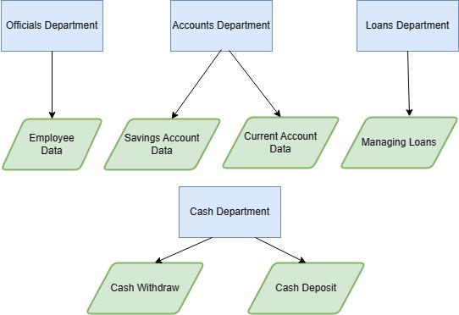
Problems of File-based Systems
Redundancy (Πλεονασμός δεδομένων)
Inconsistency (Ασυνέπεια δεδομένων)
Maintenance difficulty
Lack of concurrent access

Slide 13
File-based Systems – Redundancy
The same data are often stored in multiple files for different applications.
This leads to:
Waste of storage space
Increased probability of errors
Difficulty in synchronizing information

Slide 14
File-based Systems – Inconsistency
When the same data exist in multiple files:
Updates may be applied only to some of them
Conflicting values arise
System reliability decreases

Slide 15
File-based Systems – Maintenance Difficulty
Tight coupling makes maintenance particularly difficult:
Small changes in data structure require extensive code changes
Development and evolution costs increase
System scalability decreases

Slide 16
File-based Systems – Lack of Concurrency
File-based systems do not effectively support multiple users:
No concurrency control mechanisms
Conflicts during simultaneous writes
Risk of data loss or corruption
File-based systems were suitable for simple, single-user, small-scale applications.
However, redundancy, inconsistency, maintenance, and concurrency problems made it clear that a more structured and independent approach was necessary.
This need led directly to the development of Database Management Systems (DBMS), which address precisely these weaknesses.

Slide 17
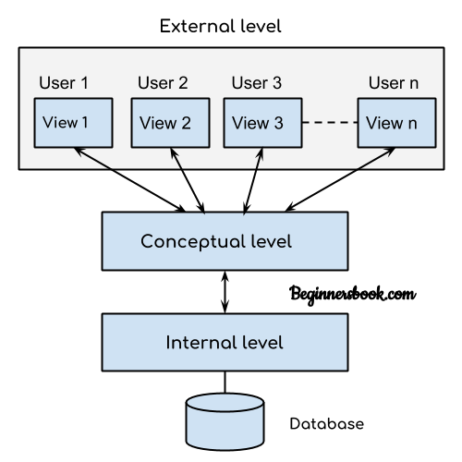
Emergence of DBMS (Database Management Systems)
The emergence of Database Management Systems (DBMS) was a direct response to the structural problems of file-based systems.
DBMS introduced an intermediate software layer between applications and storage, centrally managing data.
Thus, data cease to be the property of a single application and become a shared, controlled, and independent resource.

Slide 18
DBMS – Abstraction
The concept of abstraction is fundamental in DBMS.
The system:
Hides the details of how data are stored
Provides users and applications with a simplified logical view of data
Separates physical storage, logical structure, and access levels
Through abstraction, applications interact with data via commands and interfaces, without knowing where or how they are physically stored.

Slide 19
DBMS – Data Independence
Data independence means that:
Changes in storage mechanisms (files, indexes, partitions) do not require changes in application code
Changes in logical structure can occur without affecting users
It is distinguished into:
Physical Data Independence: Independence from physical storage details.
Logical Data Independence: Independence from schema changes.
This represents a fundamental advantage over file-based systems.

Slide 20
DBMS – Centralized Data Management
With DBMS:
Data are stored and controlled centrally
Data are shared among multiple applications and users
Unified integrity, security, and access rules are enforced
Centralized management reduces redundancy, increases consistency, and enables holistic supervision of the information system.

Slide 21
DBMS – Core Functions 1/3
CRUD (Create, Read, Update, Delete)
DBMS provide standardized operations for:
Data insertion
Information retrieval
Record updating
Data deletion
These operations constitute the core of database interaction.

Slide 22
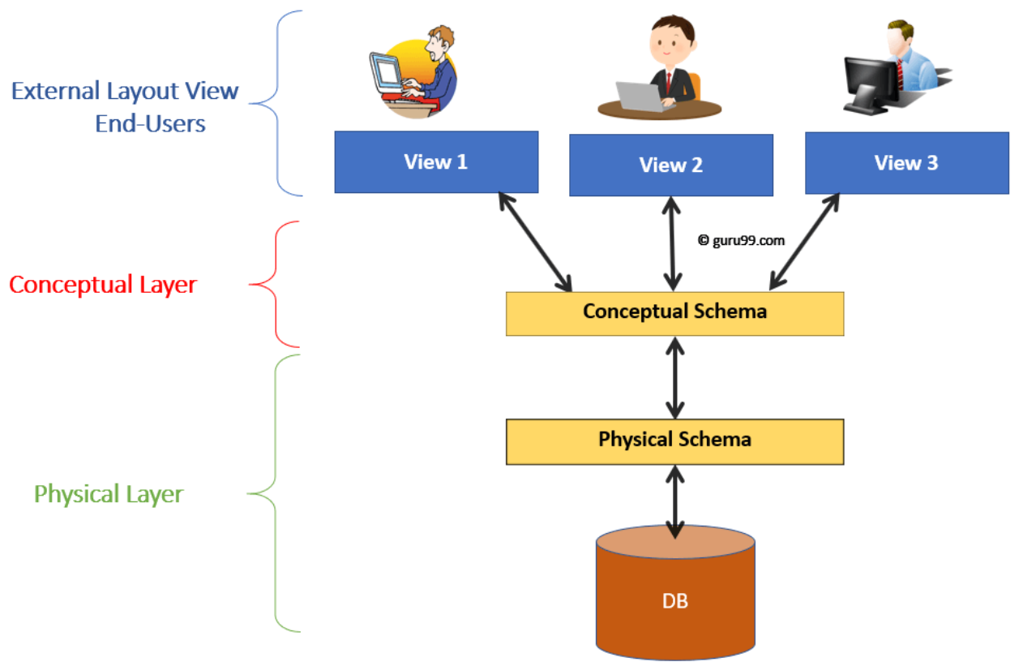
DBMS – Core Functions 2/3
Concurrency Control
DBMS allow safe concurrent access by multiple users:
Prevent write conflicts
Ensure data consistency
Implement locking and transaction mechanisms
Notes:
Concurrency Control (Έλεγχος ταυτόχρονης πρόσβασης)

Slide 23
DBMS – Core Functions 3/3
Recovery
In case of failure:
The DBMS can restore the database to a consistent state
Uses logs and rollback mechanisms
Protects data from loss or partial writes
Conclusion (DBMS Section)
The emergence of DBMS marked the transition from applications that “owned” data to systems where data are an autonomous, centrally managed resource.
Abstraction, data independence, and core functions such as CRUD, concurrency control, and recovery constitute the cornerstone of every modern information system.

Slide 24
The Dominance of Relational Databases
Relational databases prevailed as the dominant model of data storage and management for decades because they provided a strict, mathematically grounded, and universally understandable way of organizing data.
The relational model offered clear structure, formal rules, and a high degree of reliability — essential characteristics for enterprise and mission-critical systems.

Slide 25
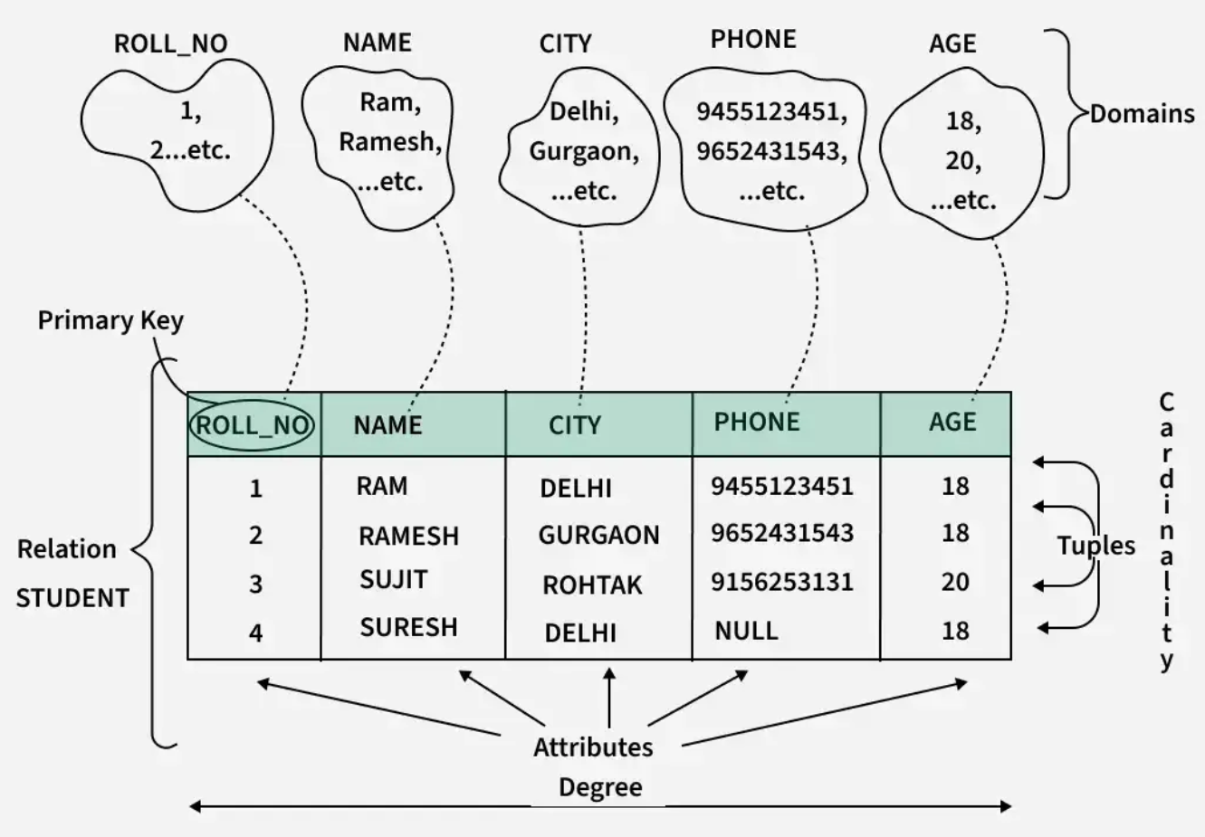

Slide 26
Relational Model
The relational model is based on set theory and relational algebra.
Data are represented as sets of tuples organized into relations.
Each relation:
Has a clearly defined schema
Consists of attributes with specified data types
Is subject to integrity constraints
This strict definition enabled data independence and rigorous consistency enforcement.

Slide 27
Tables, Relations, Keys
In practical implementation:
Tables correspond to relations
Rows represent records (entities)
Columns represent attributes
Keys ensure uniqueness and relationships:
Primary Key: Unique identifier of each record
Foreign Key: Link between tables
Constraints: Rules that preserve data integrity
In this way, complex data structures are modeled in a simple and standardized manner.

Slide 28
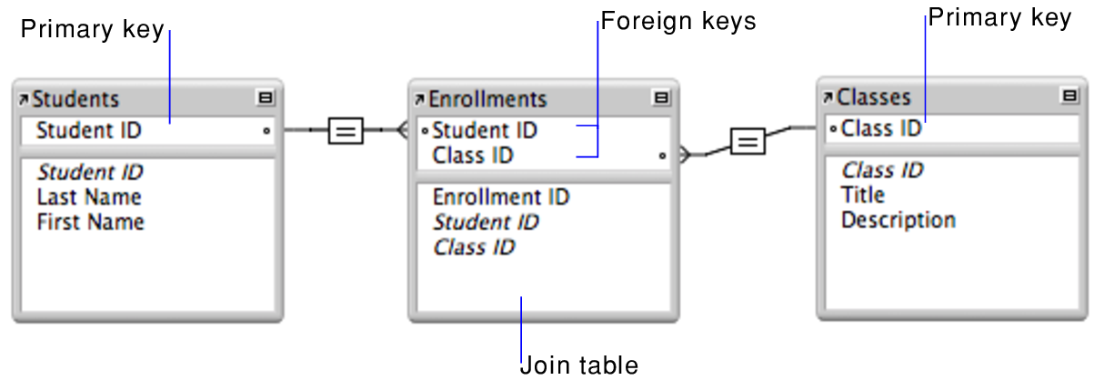

Slide 29
SQL as a Universal Language
SQL (Structured Query Language) was established as the universal language for interacting with relational databases.
It provides:
Declarative query specification
Independence from physical storage
Unified standard for CRUD operations
Schema definition and access control
The user describes what needs to be retrieved, not how, leaving execution optimization to the DBMS.

Slide 30
ACID Properties
The reliability of relational databases is based on the ACID properties of transactions:
Atomicity: Each transaction is executed entirely or not at all.
Consistency: The database transitions from one valid state to another.
Isolation: Concurrent transactions do not interfere with each other.
Durability: Data remain stored even after system failure.
ACID properties make relational databases suitable for banking, accounting, and other critical systems.

Slide 31
Relational Databases – Conclusion
The dominance of relational databases was not accidental.
The combination of:
A strict relational model
The universal SQL language
ACID guarantees
created a stable, reliable, and scalable foundation for large-scale information systems.
This background explains why relational databases remain a reference point even in the modern era of NoSQL systems.

Slide 32
Limits of RDBMS & Big Data

Slide 33
What Changed in the Application World
The classical era of information systems was based on relatively stable, small-scale, and internal applications.
Today, the application environment has been radically transformed, leading to explosive growth in data volume, number of users, update rate, and system complexity — often beyond the design assumptions of traditional RDBMS.

Slide 34
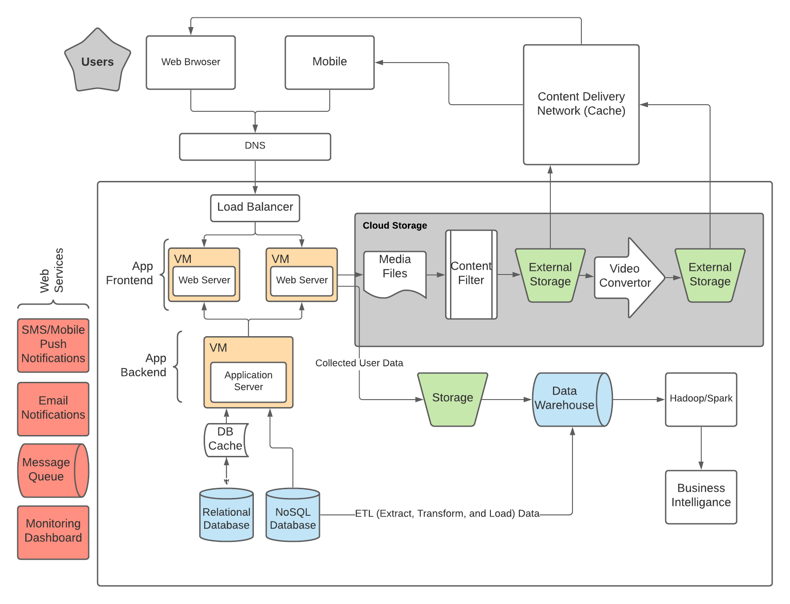
Web Applications
Applications moved from local systems to globally accessible web platforms, serving millions of concurrent users.
They are characterized by:
High concurrency
Intensive read/write traffic
Need for horizontal scalability
Low latency requirements

Slide 36
Mobile Users
The dominance of smartphones introduced:
Continuous real-time data generation
Geospatial information
Asynchronous and unstable connectivity
Demand for immediate response
Offline-first architectures
Databases are now required to serve mobile, distributed, and dynamic data flows.

Slide 37
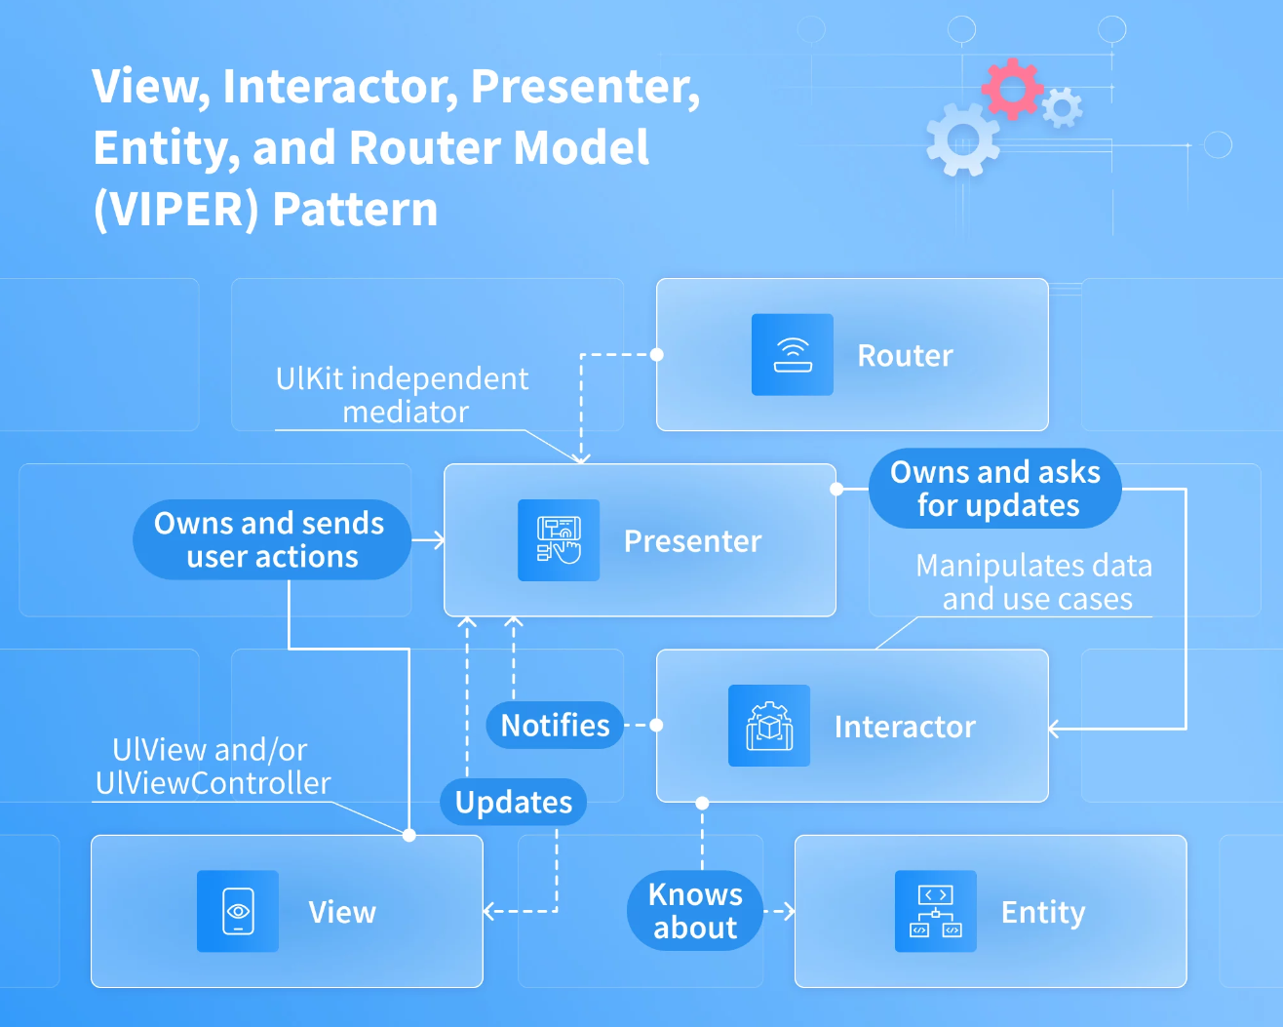

Slide 38
Social Networks
Social networks generated:
Massive volumes of unstructured data (posts, media, reactions)
Graph relationships between users
Complex recommendation and graph queries
Extremely high write throughput
Data are no longer only tables — they are graph structures, streams, and dynamic social graphs.

Slide 39
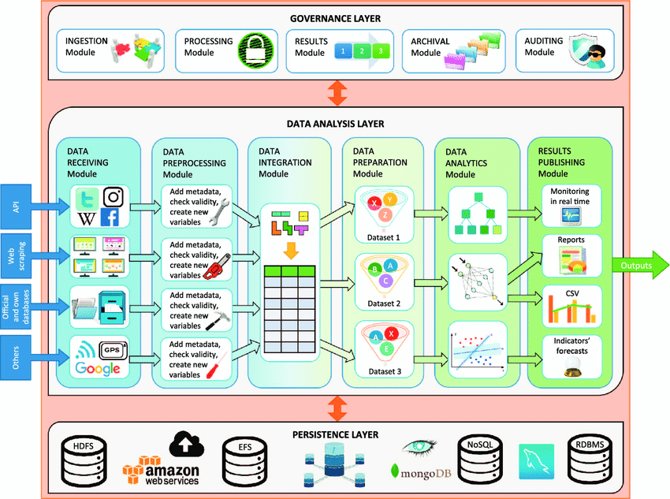

Slide 40
Cloud Computing
The transition to cloud computing imposed:
Distributed data storage across multiple data centers
Elastic scaling
Node failure tolerance
Geographic distribution of users and workloads
Databases must operate in distributed, fault-tolerant, multi-region environments.

Slide 41
IoT and Sensors
The expansion of the Internet of Things introduced:
Continuous data streams from millions of devices
High-frequency time-series data
Need for real-time ingestion and analytics
Huge volume of low-value-per-record data but extremely high overall scale
Data are now generated automatically, continuously, and in real time.

Slide 42
Conclusion
The world of applications shifted from static, small-scale, and structured data usage to a massive, distributed, high-speed, and heterogeneous environment.
This transformation is the primary reason traditional RDBMS reach their limits and it paved the way for Big Data platforms and NoSQL architectures.

Slide 43
New Requirements
The radical transformation of the application ecosystem created a set of new, non-negotiable requirements for data systems.
These requirements no longer concern only correct storage, but continuous, global, and immediate access under extreme scale.

Slide 44
New Requirements – Massive Number of Users
Modern systems serve:
Millions or even billions of users
High levels of concurrency
Highly variable workloads
The classical RDBMS architecture proves insufficient, as scalability must be horizontal and dynamic.

Slide 45
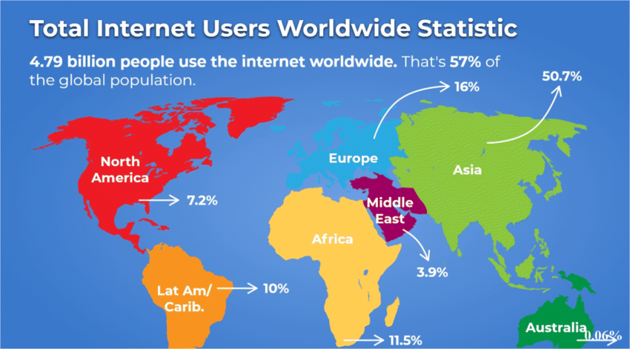

Slide 46
New Requirements – 24/7 Availability
Modern applications:
Do not tolerate downtime
Require uninterrupted operation
Must withstand hardware, network, or software failures
High availability is no longer optional — it is a fundamental design requirement.

Slide 47
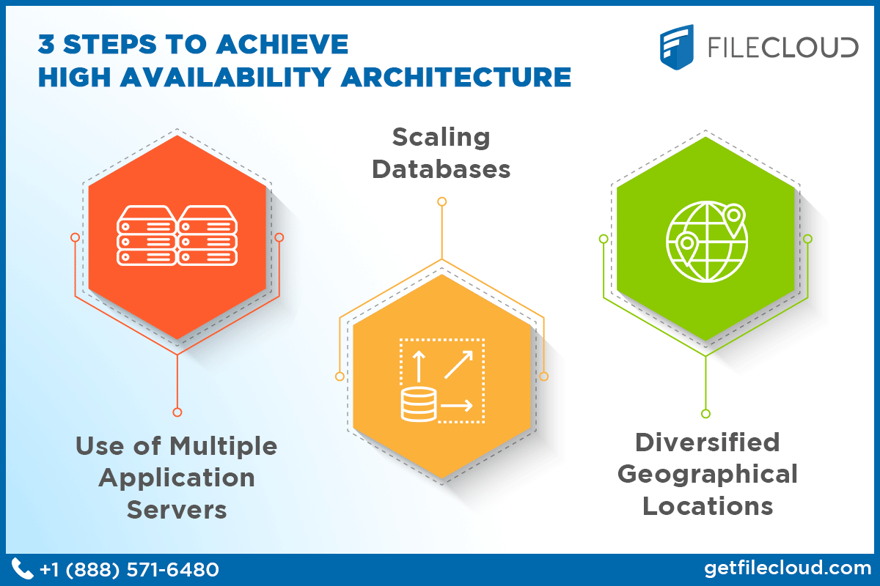
New Requirements – Global Distribution
Users are geographically distributed:
Across continents
With different network conditions and latencies
Requiring access to the same datasets
This necessitates geographically distributed databases with replication and synchronization between data centers.

Slide 48
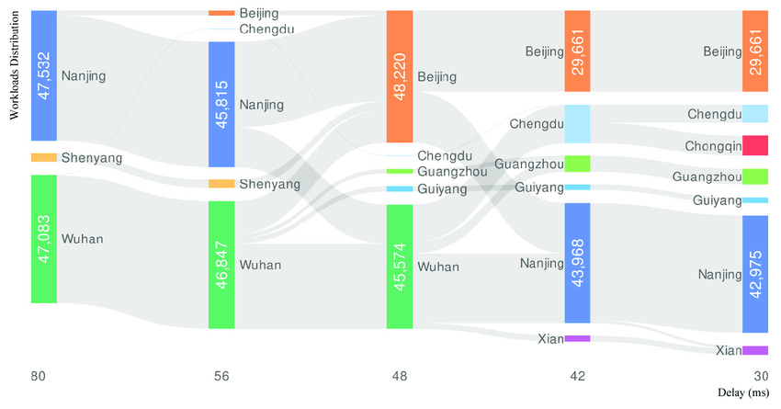
New Requirements – Low Latency
User experience depends on:
Millisecond-level responses
Immediate data retrieval and updates
Predictable performance regardless of load
Even small delays result in user or revenue loss, making latency a critical design factor.
Notes:
Η εικόνα δείχνει ένα διάγραμμα Sankey που απεικονίζει την κατανομή workloads (φορτίου εργασίας) μεταξύ πόλεων, καθώς αλλάζει η καθυστέρηση δικτύου (delay σε ms).,
Τι βλέπουμε δομικά
Στον οριζόντιο άξονα υπάρχουν διαφορετικά επίπεδα καθυστέρησης:
80 ms
56 ms
48 ms
42 ms
30 ms
Οι κάθετες μπάρες είναι πόλεις (π.χ. Nanjing, Wuhan, Beijing κ.λπ.)
Οι αριθμοί μέσα στις μπάρες δείχνουν το workload που έχει ανατεθεί σε κάθε πόλη.
Οι γκρι ροές δείχνουν πώς μετακινείται το workload από πόλη σε πόλη όταν αλλάζει το delay.
Το διάγραμμα δείχνει πώς ένα σύστημα (πιθανόν distributed cloud / edge infrastructure) ανακατανέμει υπολογιστικό φορτίο μεταξύ data centers, όταν η καθυστέρηση δικτύου μειώνεται.

Slide 49
New Requirements – Conclusion
The new requirements shift the emphasis from maximum consistency to availability, scalability, and global performance.
This gap between requirements and traditional relational databases explains why alternative data architectures emerged — designed from the outset for large-scale distributed systems.

Slide 50
Big Data — Definition
The term Big Data describes datasets whose scale, speed, and heterogeneity exceed the capabilities of traditional data systems in terms of storage, processing, and analysis.
It is not simply about more data, but about a qualitative transformation in the way data are generated, flow, and are utilized.

Slide 51
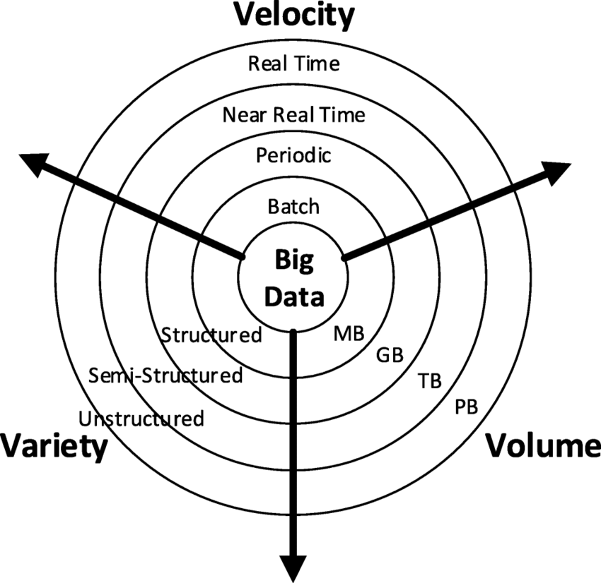
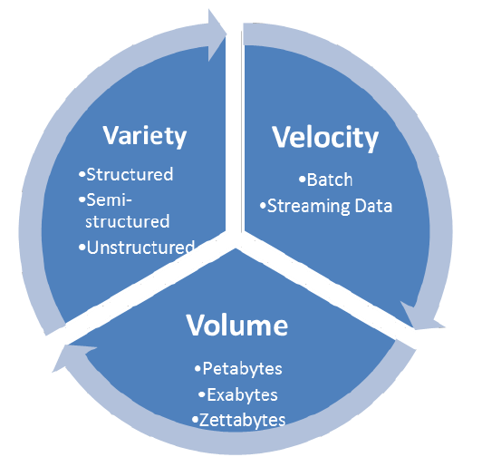

Slide 52
Big Data – Volume
Volume refers to:
The enormous amount of data generated and stored
Data sizes ranging from terabytes to petabytes and beyond
Continuously and cumulatively growing datasets
This magnitude makes management through traditional monolithic databases impractical.

Slide 53
Big Data – Velocity
Velocity concerns:
The rate at which data are generated and arrive
Continuous streaming in real or near-real time
The need for immediate processing and response
Examples include sensors, user clicks, system logs, and social media activity.

Slide 54
Big Data – Variety
Variety describes:
The coexistence of structured, semi-structured, and unstructured data
Different schemas, formats, and models
Text, images, video, graphs, time-series data
This heterogeneity challenges the rigid structure of traditional relational models.
Notes:
Διδακτική Σημείωση
Τα Big Data δεν είναι απλώς “πολλά δεδομένα”. Είναι δεδομένα:
διαφορετικού τύπου,
διαφορετικού ρυθμού,
συχνά χωρίς προκαθορισμένο σχήμα.
Αυτός ο συνδυασμός είναι που δημιουργεί τις πραγματικές τεχνολογικές προκλήσεις και οδηγεί στην ανάγκη για νέα

Slide 55
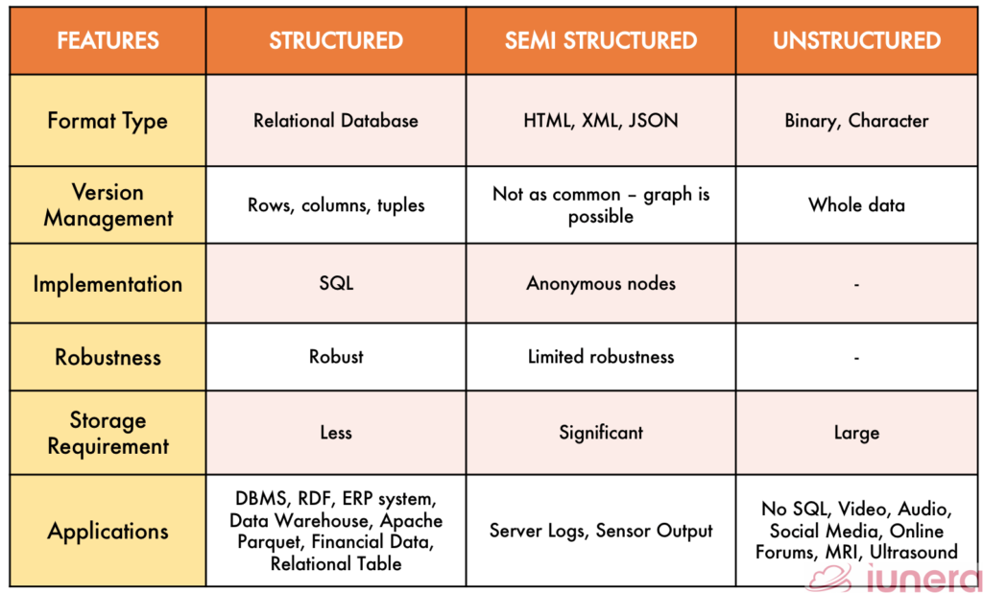

Slide 56
Vertical vs Horizontal Scaling
Scalability is a critical issue in modern data systems.
There are two fundamentally different approaches:
Vertical scaling (scale-up)
Horizontal scaling (scale-out)
The choice between them has significant technical and economic implications.

Slide 57
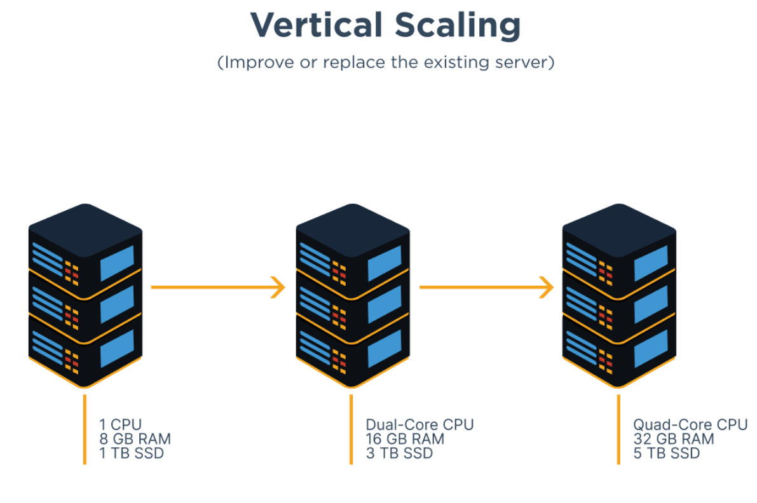
Scale-up (Vertical Scaling)
Vertical scaling is based on upgrading a single server:
More CPU
More memory
Faster disks
Characteristics:
Simple architecture
Single central management point
Limited upper scalability bound
This approach is historically associated with traditional RDBMS.

Slide 58
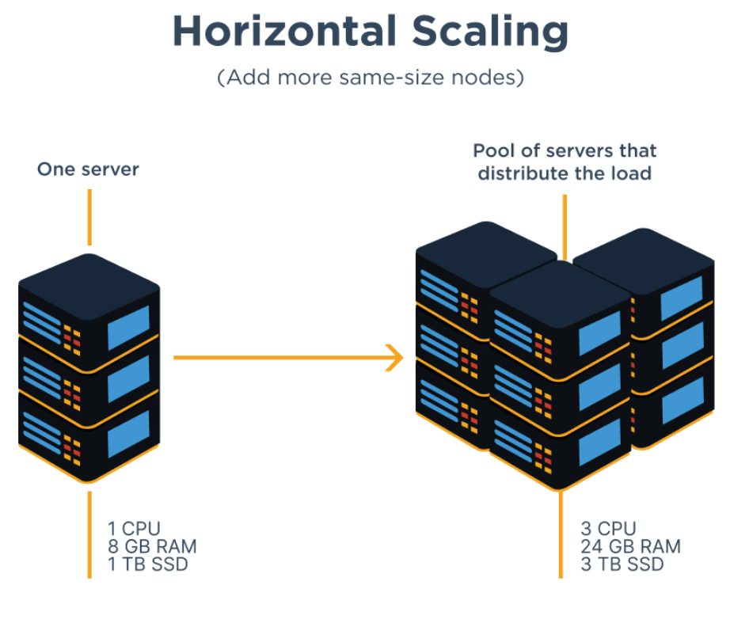
Scale-out (Horizontal Scaling)
Horizontal scaling is based on adding more servers:
Data partitioning (sharding)
Replication
Parallel processing
Characteristics:
Theoretically unlimited scalability
Fault tolerance against node failures
Increased synchronization complexity
It constitutes the core design principle of Big Data and NoSQL systems.

Slide 59
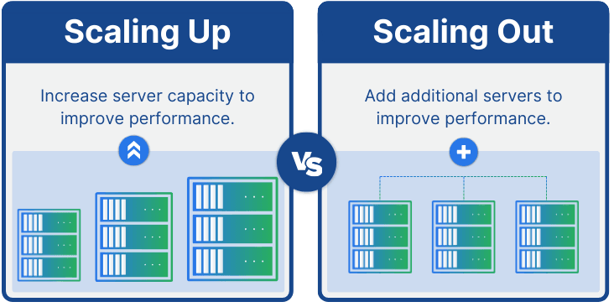
Vertical vs Horizontal Scaling – Economic Implications
Scale-up:
Expensive specialized hardware
Exponential cost growth for marginal performance gains
Vendor lock-in
Scale-out:
Use of commodity hardware
Gradual investment based on workload
Better cost-performance ratio at large scale

Slide 60
Vertical vs Horizontal Scaling – Technical Implications
Scale-up:
Simpler consistency management
Limited availability
Single point of failure
Scale-out:
Distributed data and computation
Need for replication and consistency models
Introduction of latency and synchronization challenges

Slide 61
Vertical vs Horizontal Scaling – Conclusion
Traditional RDBMS were primarily designed for scale-up environments.
The world of Big Data requires scale-out architectures, where scalability, availability, and fault tolerance are achieved through distributed systems — at the cost of increased complexity.

Slide 62
Limitations of RDBMS
Although relational database systems remain highly reliable, their design is based on assumptions that do not align with the requirements of modern, distributed, large-scale applications.
Their core limitations become evident in Big Data environments.

Slide 63
Limitations of RDBMS – Difficulty in Scale-out
RDBMS were designed primarily for vertical scaling:
Horizontal data distribution is complex
Sharding requires manual design
Maintaining ACID properties across multiple nodes is expensive
As a result, horizontal scalability is not an inherent characteristic of classical RDBMS.
Notes:
Sharding involves separating different rows of information from the table and storing them on different machines

Slide 64
Limitations of RDBMS – Fixed Schema
The strict and predefined schema:
Requires full knowledge of data structure in advance
Slows rapid application evolution
Makes changes costly in large datasets
In dynamic and heterogeneous environments, fixed schemas act as a restrictive factor.

Slide 65
Limitations of RDBMS – Expensive Joins
Joins are a fundamental feature of RDBMS, but:
In distributed environments, they require data movement between nodes
They significantly increase latency
They limit scalability at large scale
In Big Data scenarios, joins become a major performance bottleneck.

Slide 66
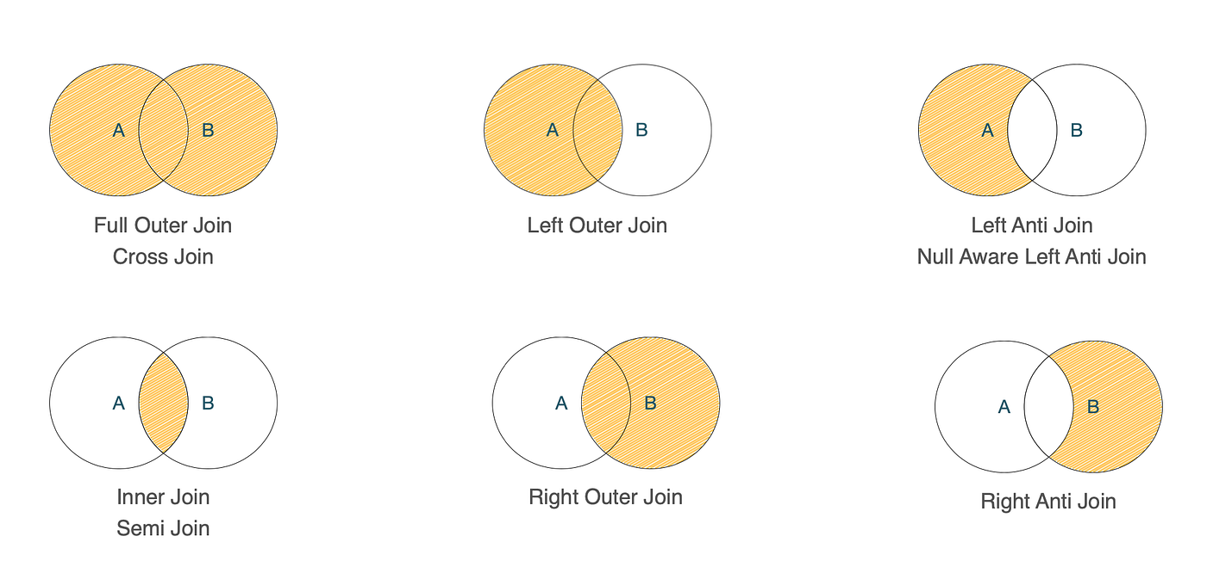

Slide 67
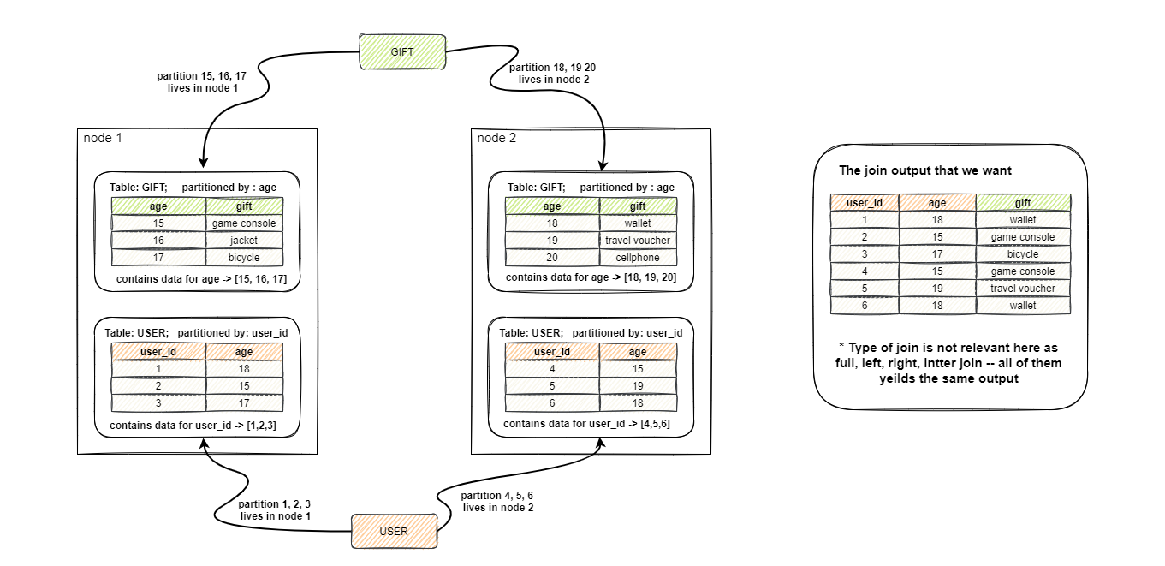

Slide 68
Limitations of RDBMS – Complex Distributed Consistency
Maintaining strong consistency:
Requires synchronization across nodes
Increases response time
Reduces availability during network failures
Distributed implementation of ACID guarantees becomes extremely complex and often impractical at global scale.

Slide 69
Limitations of RDBMS – Conclusion
The limitations of RDBMS are not technological failures, but consequences of their original design goals.
The gap between those goals and modern requirements explains why alternative data models emerged — designed from the outset for distributed operation, scalability, and flexibility.

Slide 70
The Problem Is NOT SQL
In discussions around Big Data and NoSQL systems, it is often mistakenly assumed that SQL is the limiting factor.
In reality, SQL remains one of the most powerful and expressive data management languages.
The issue does not lie in the language, but in the underlying data model and architectural implementation of traditional RDBMS.

Slide 71
SQL Is Powerful
SQL:
Is declarative and expressive
Supports complex queries and analytics
Provides strict semantics and clear modeling
Has decades of maturity and a vast ecosystem
This language did not “fail” — it continues to serve as the foundation of many modern systems.

Slide 72
Σας Ευχαριστώ (Thank you)

